Slide 1
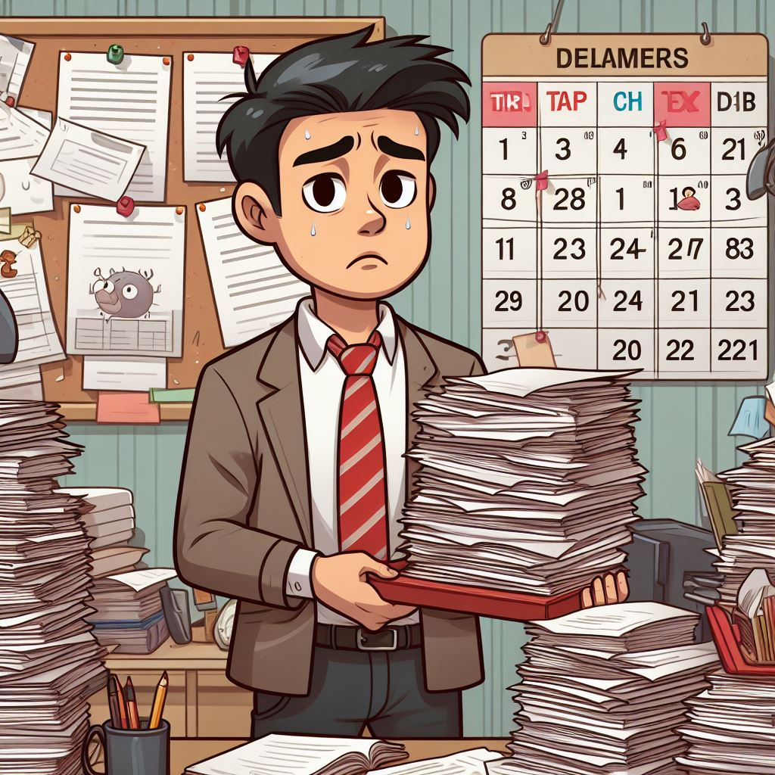
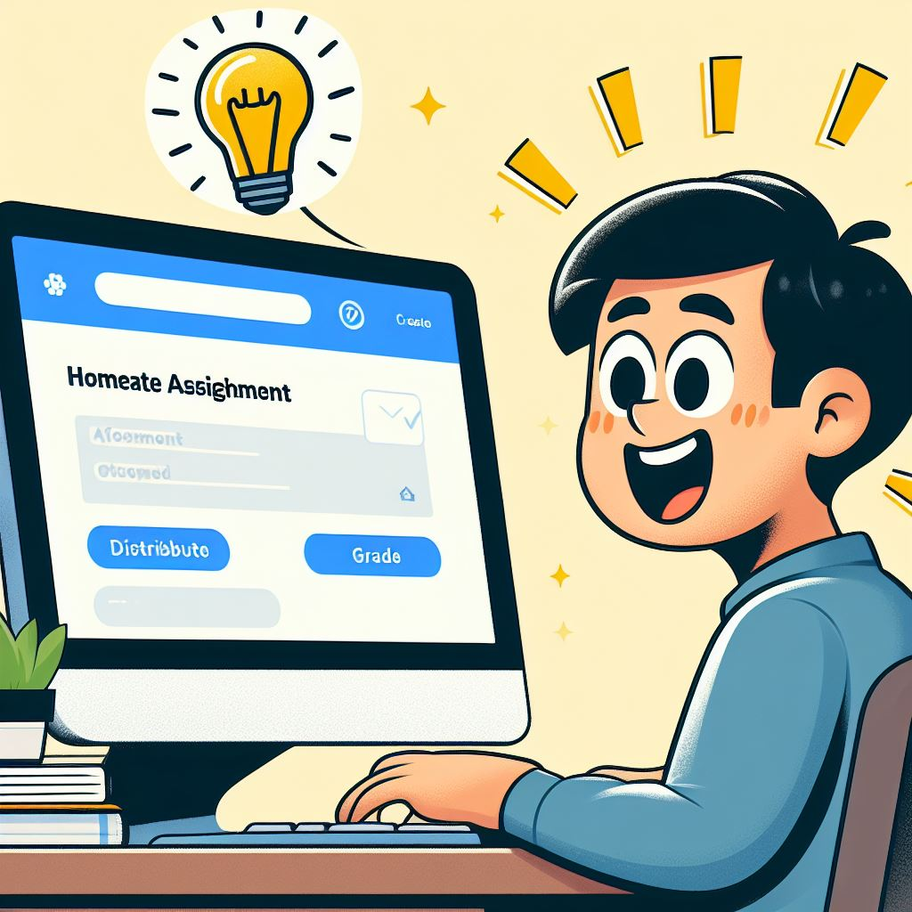
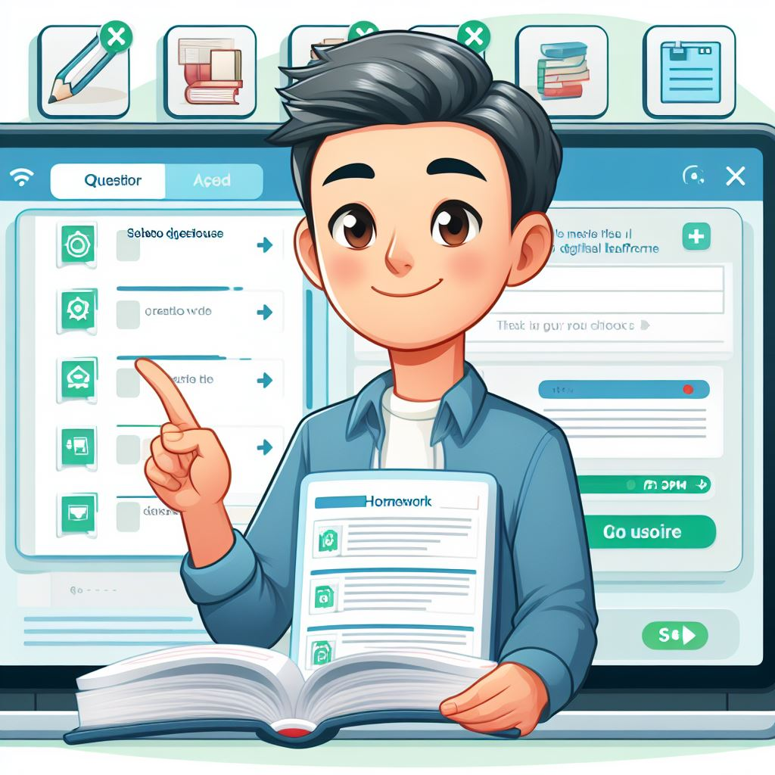
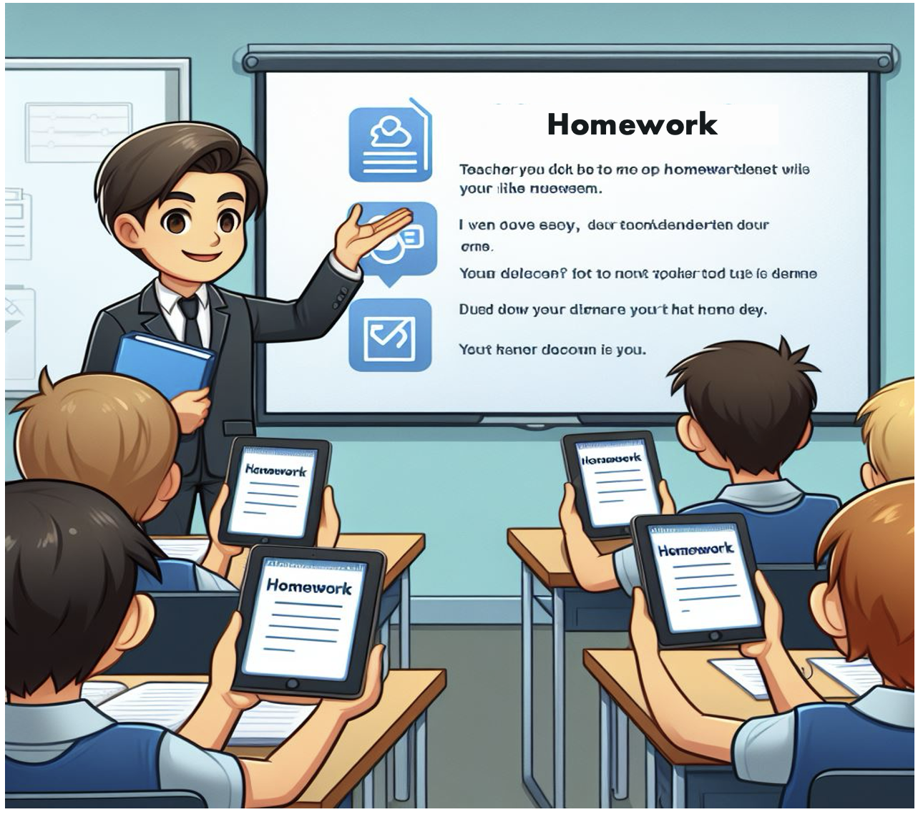
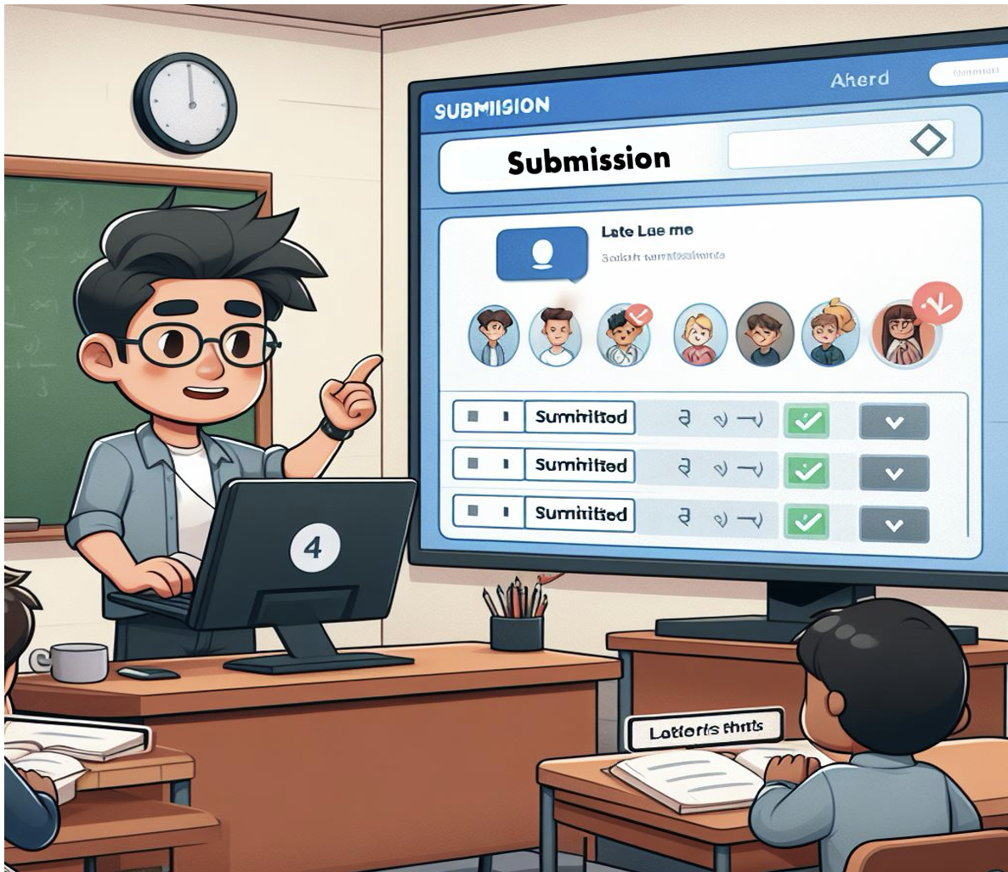

UX Design Storyboard
Scenario: A digital homework management system that enables teachers to create, distribute, collect, grade, and provide feedback on assignments.
Mr. George’s desk is messy with papers. He looks tired and worried about the homework grading.
Mr. George’s discovers EduConnect app on his computer. He is surprised and interested.
Mr. George is happy using the app to design homework. The app provides template and question banks.
Mr. George assigns the homework to students who works on tablets electronically.
All students' homework is submitted through the app. Mr. George can monitor each student’s progress.
With more effective feedback on assignments, Mr. George happily finds student’s performance improved.

